Slide 1
What is Software
Software is a set of instructions, data or program used to operate computers and perform specific tasks.
Types of software
1. System software
2. Application software

Slide 2

What is Software Testing?

Slide 3
What is Software testing?
Software testing is the process of evaluating and verifying that a software product or application meets its requirement and functions as expected.

Slide 4
What is Software Quality?

Slide 5
What is Software Quality
Software quality refers to the degree to which a software product meets specified requirement and user expectations, encompassing its functionality, reliability, usability and Maintainability.

Slide 6
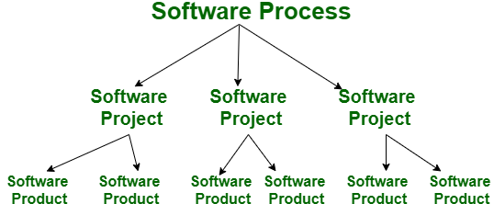
Project vs Product
Project: A project refers to the series of steps involved in creating software before it becomes available to the market. Once the project is completed, the outcome is termed as a product
Product: The software is built by developers on requests from the customer. After the customer is satisfied with the development process, he launches the software by manufacturing it.

Slide 7

Why do we need Testing?

Slide 8
Why do we need testing?
Testing in software is essential because it helps ensure that the software works correctly, reliably and safely before it is released to the users.
Key reasons why testing need:
To find and fix bug
To ensure functionality
To improve security
To enhance performance
To ensure compatibility

Slide 9
Error, Bug and Failure
Error
An error is a mistake a coder makes during the software development process.
Bug:
The incorrect part of the software code or design caused by an error.
Failure:
The system behaves incorrectly during execution because of a fault.

Slide 10
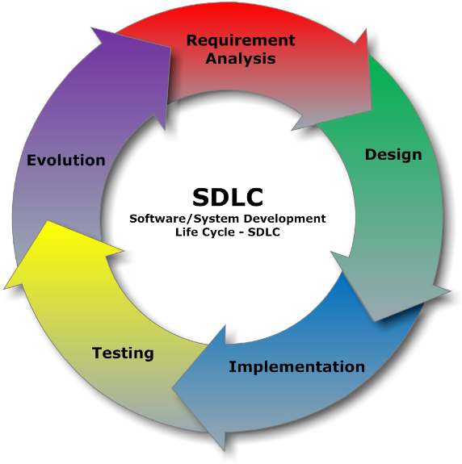
SDLC
Software Development Life Cycle (SDLC) is a structured process that is used to design, develop, and test high-quality software.
The goal of the SDLC life cycle model is to deliver high-quality, maintainable software that meets the user's requirements.

Slide 11
Software Methodologies
Software methodologies are the various strategies or approaches used to test an application to ensure it behaves and looks as expected.
Main Software Methodologies:
Waterfall
Agile
Spiral
V-model

Slide 12
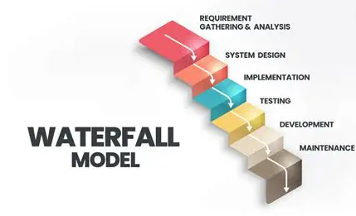
Waterfall Methodology
It is a sequential development process that flows like waterfall through all the phases of projects.

Slide 13
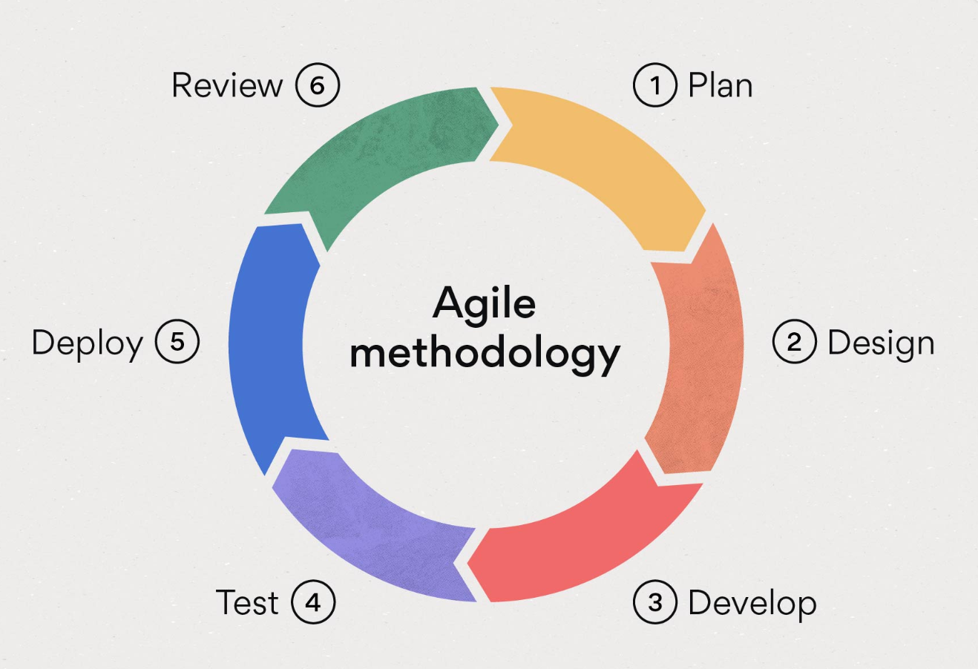
Agile Methodology
Agile methodology is a software testing practice that follows the Agile software development methodology

Slide 14
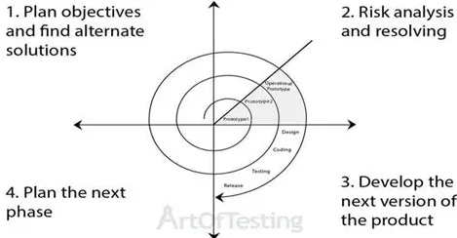
Spiral Model
Spiral Model is an iterative and risk-driven approach and it is a way of developing software in repeated cycles, while checking for risks at every step.

Slide 15
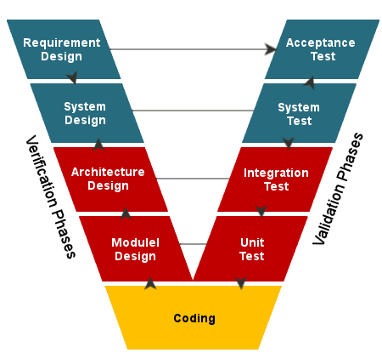
V-Model
V-Model (Verification and Validation Model) is a way of developing software where testing is planned in parallel with development.

Slide 16
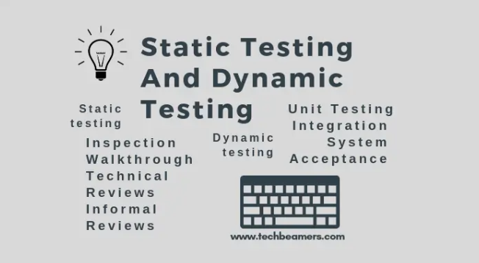
Static testing and Dynamic testing

Slide 17
Software Testing Methods
Software testing methods are different ways to test software to find bugs and make sure it works correctly.
Main Types of Software Testing Methods:
1. Black-Box Testing
2. White-Box Testing

Slide 18
Black-Box testing
Black-Box testing is a software testing method where the tester has no knowledge of the internal structure or working of the application is being tested.
Common types of Black-Box Testing
Regression Testing
Sanity Testing
Smoke Testing
User Acceptance Testing (UAT)

Slide 19
White-Box Testing
White-Box Testing is a software testing method where the tester has knowledge of the internal structure, design, and code of the software being tested.
Common types of White-Box Testing
Unit Testing
Code coverage Testing
Integration testing

Slide 20
Testing types
Regression Testing: It is full or partial selection of already executed test cases that are re-executed to ensure the existing functionalities are working fine
Sanity Testing: It is a quick check to see if a specific part of the software works after small changes or bug fixes.
Smoke Testing: It is a basic, quick test to check if the main functionality of software works.
Unit Testing: It means testing the smallest part of the code like a single functionality or module, by itself.
Integration testing: Checking if different units, modules of software applications are tested as combined entity.
System Testing: It evaluates the complete and integrated software system to ensure it meets the specified requirements and it tests the entire system as a whole, including both functional and non-functional.
UAT Testing: End user can test the application before the production go live.

Slide 21
Testing types
Performance Testing: It is the process that evaluates how well an application perform under specific conditions, focusing on its speed, stability under varying work-loads
Usability testing: It checks how easy and friendly the software is for real users.
Re-Testing: It means testing a bug or issue again after it has been fixed.
Exploratory Testing: The testers use the software freely to find bugs without following pre-written test cases.
Adhoc Testing: It is unplanned and informal testing, testers just try to break the software in any way they can.
Monkey testing: It is using the software in completely random ways. Testers do anything without any plans, to see if it breaks.
End-to-End testing: It is the testing the entire application from start to end, just like a real user would, to make sure all parts work together correctly.

Slide 22
Testing types
Positive Testing: Testing the software with valid inputs to check if it works as expected.
1
Negative Testing: Testing the software with invalid inputs to check if it handles errors properly.
2

Slide 23
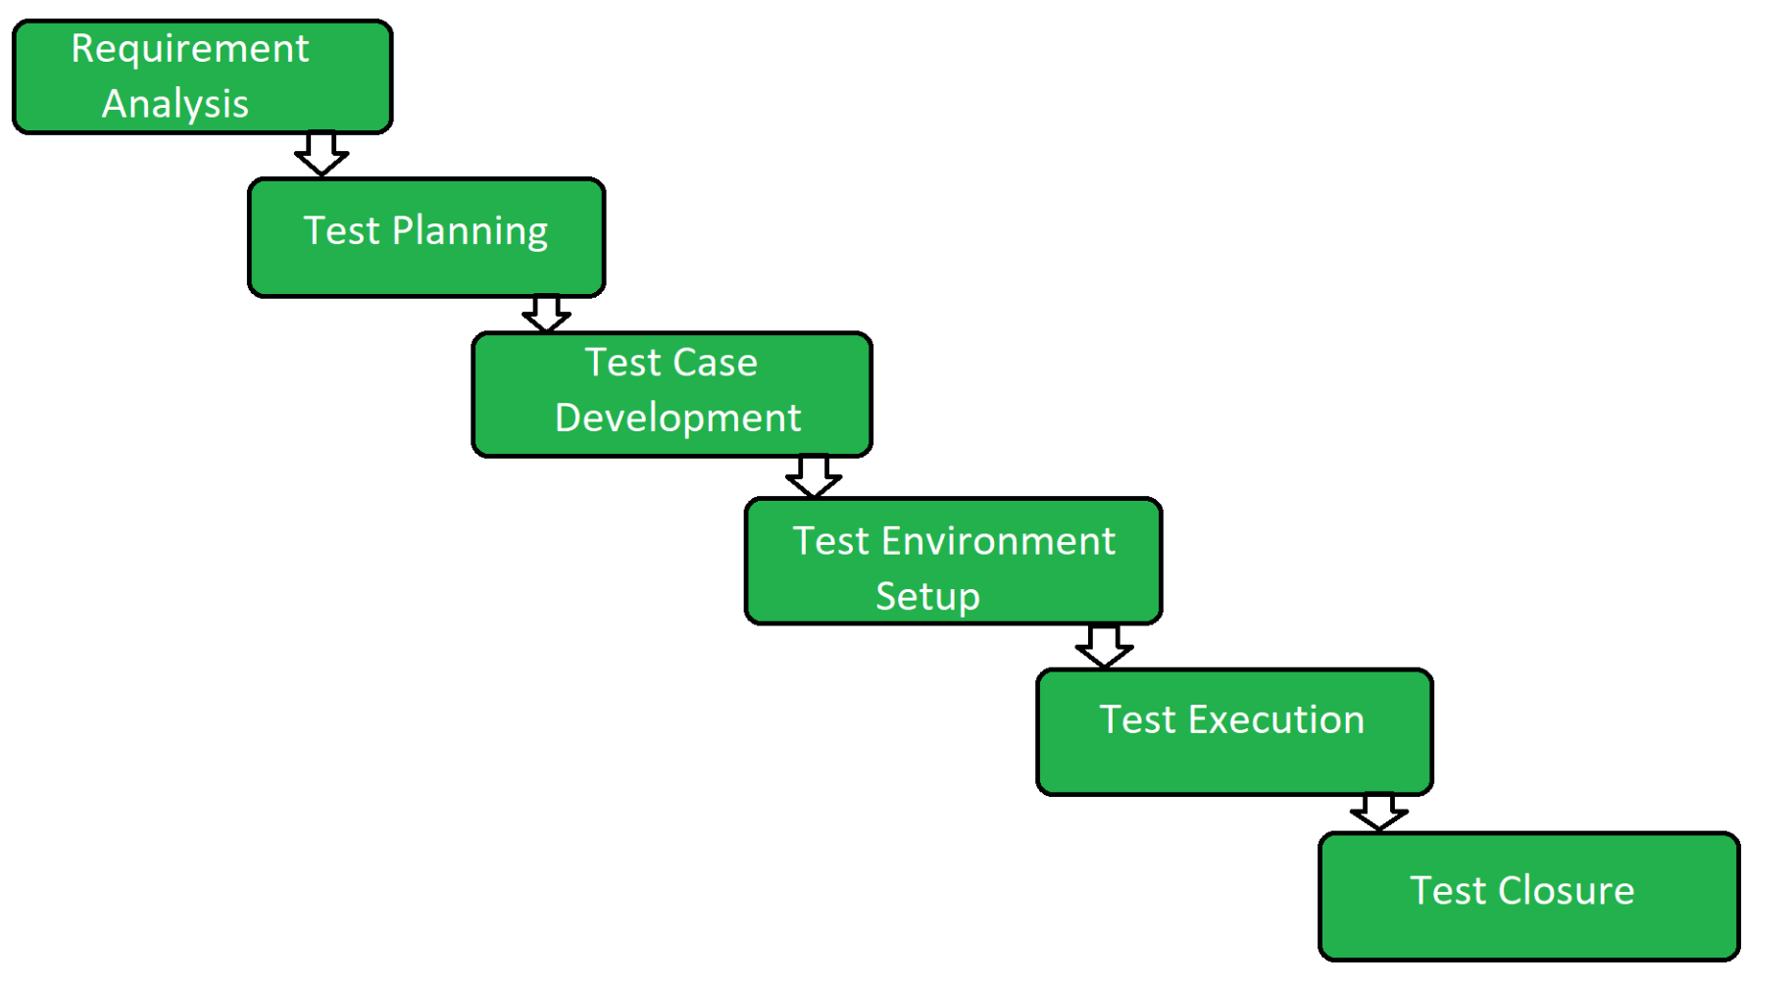
STLC
STLC means Software Testing Life Cycle
It is a structured sequence of activities performed during the software testing process.

Slide 24


